Slide 1
Mission 7 Remix
Create your own project from Mission 7

Slide 2

Warm-up
In your Mission 7 Remix Log, answer the pre-mission preparation questions:
How would you use a list in math or science?
What could you use a list for in another subject?

Slide 3

Time for a project remix!
A remix can be:
A new program created by adding new code to a program you already created
You can combine parts of two or more programs in a remix
Use a similar idea in a different way

Slide 4
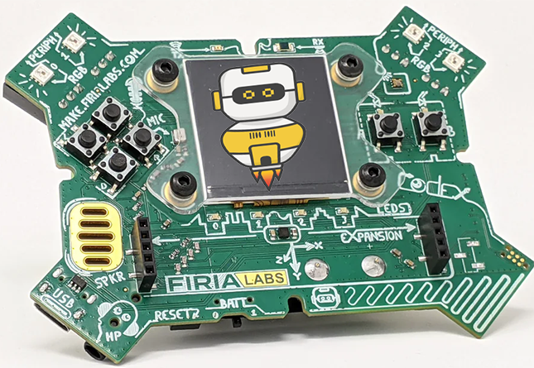
Project Remix
Creating a remix will let you:
Improve your skills and practice the concepts from the mission
Be creative
Remember code from earlier programs and missions
Work with other students
Design an original program and write the code all on your own

Slide 5
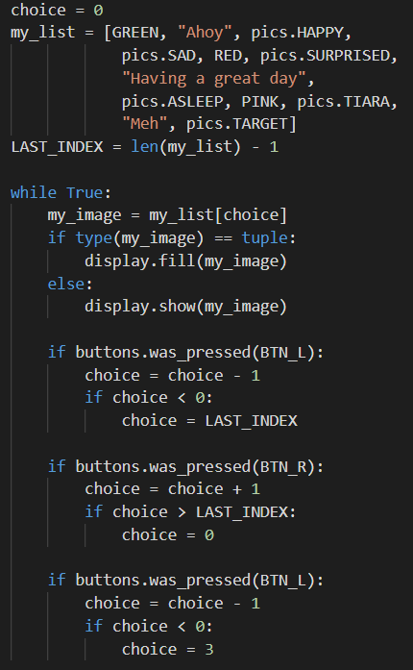
Step #1
Review the mission
Open your project from
Mission 7
  What does the program do?
  What skills were used or concepts learned?
DO THIS:
Fill out the information in the Mission 7 Remix Log for Step 1

Slide 6
Step #2
Brainstorm ideas
Read through remix suggestions from your teacher
Eight suggestions are on the next 4 slides. You can use any of these ideas or come up with your own.

Slide 7
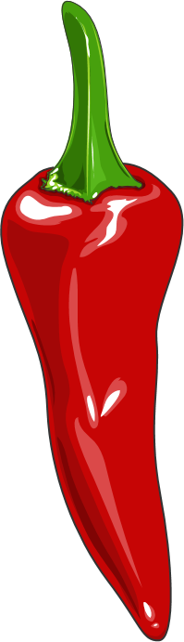
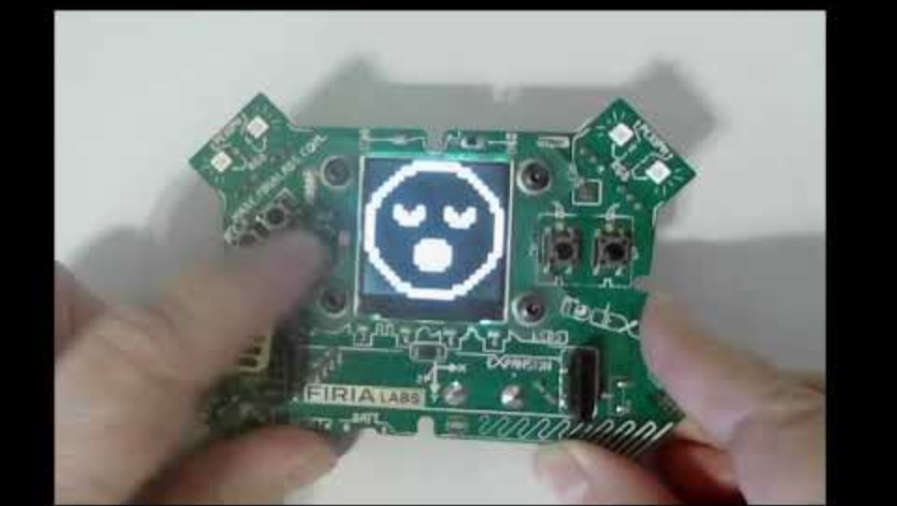
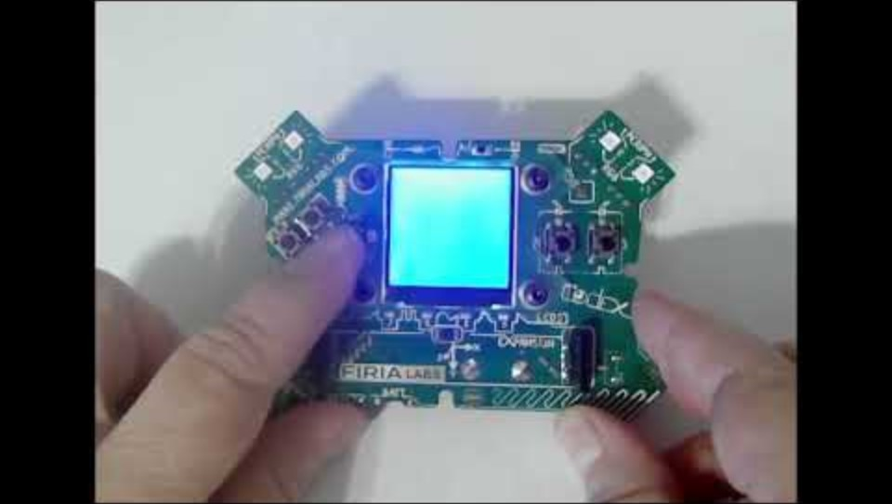
Step #2 Remix Ideas
Mild-1A
Select a button (other than L or R) and add an if statement that will break out of the loop to stop the program.
Mild-1B
Create a list of 6 items (images, text or colors). Assign a value to choice when the button is pressed. Then display the image, text, or color from the list -- no scrolling needed.

Slide 8
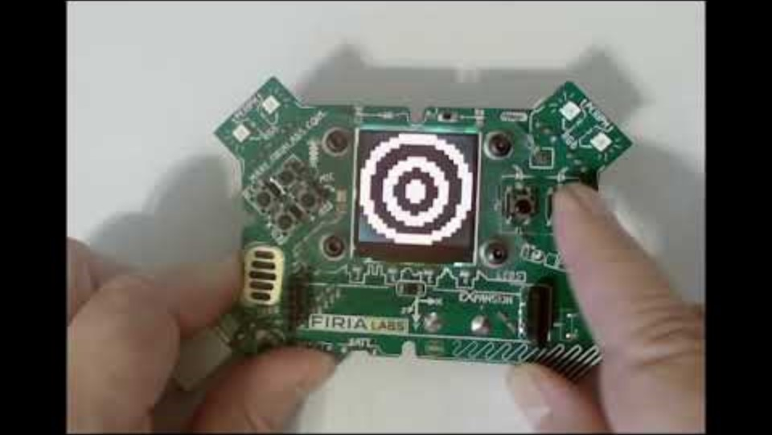
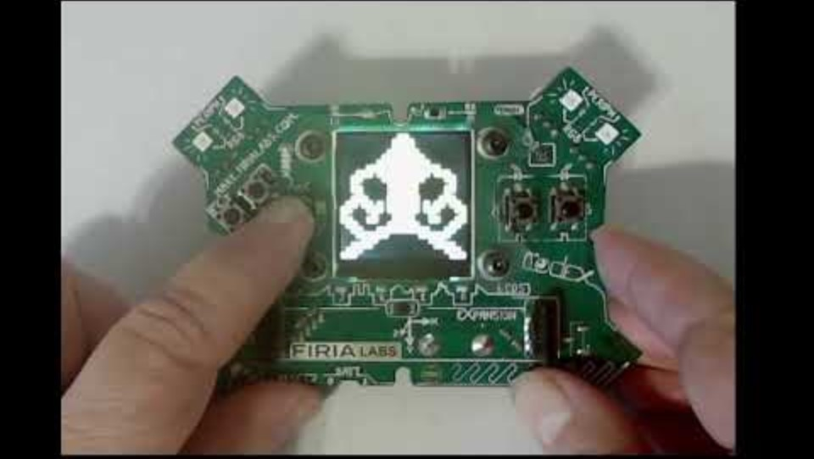
Step #2 Remix Ideas
Medium-2B
Add print statements that introduce the program, and add a loop that will “wait” until a button is pressed to begin. Also include a button that will break out of the loop and stop the program. Display an ending message.
Medium-2A
Create a list of 6 items, like Mild #2. At the beginning, and after each item, clear the screen to black and print “Press a button”.

Slide 9
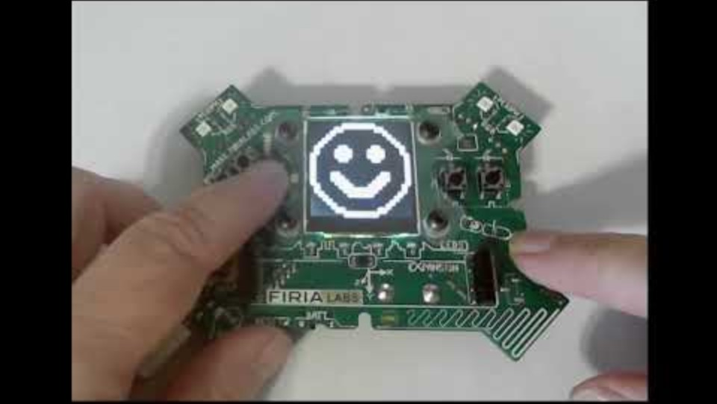
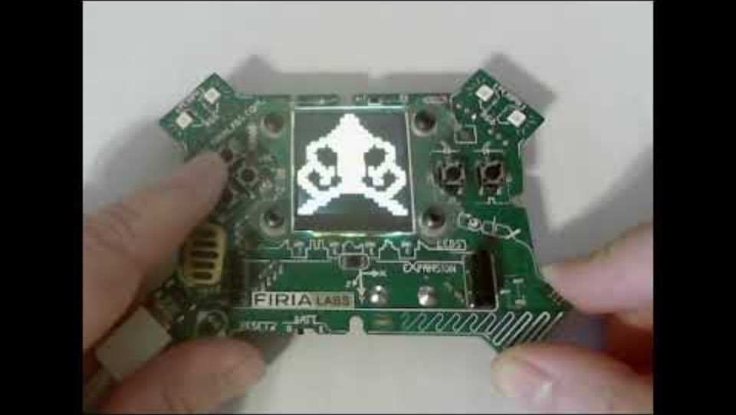
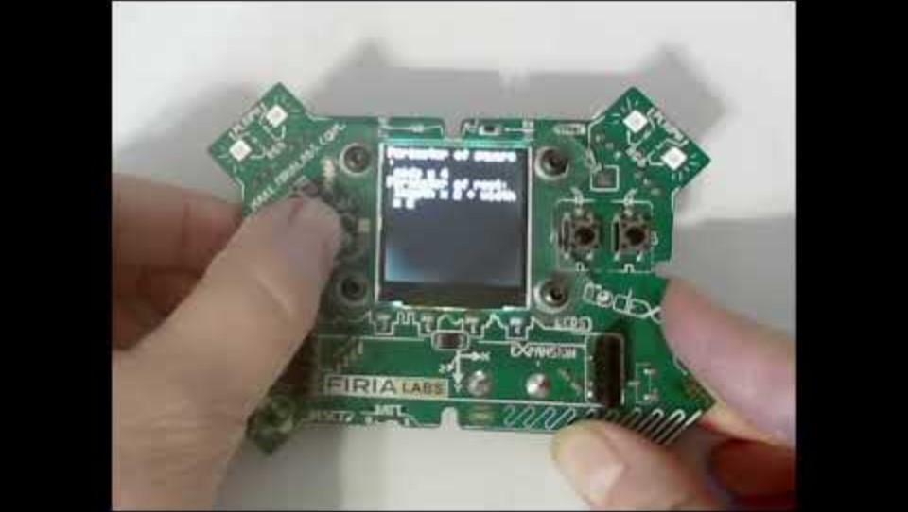
Step #2
Medium-2D
Create a list of text strings with facts from math, science, history, etc. Scroll through and display the list of facts. You will need to sleep(), clear the display, and print a scroll message.
HINT: use \n in a string to print on a new line
Example:
display.print(“Hello \nthere”)
will print hello
there
Medium-2C
Create two lists: one for images and one for sounds. Using the same “choice” variable, display an image and play a sound. You can use the audio sound files or tones.
Example:
audio.pitch(440, delay)

Slide 10
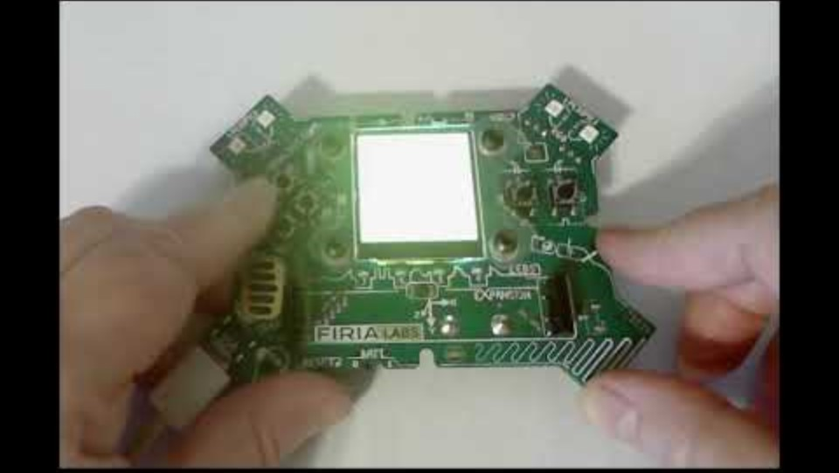
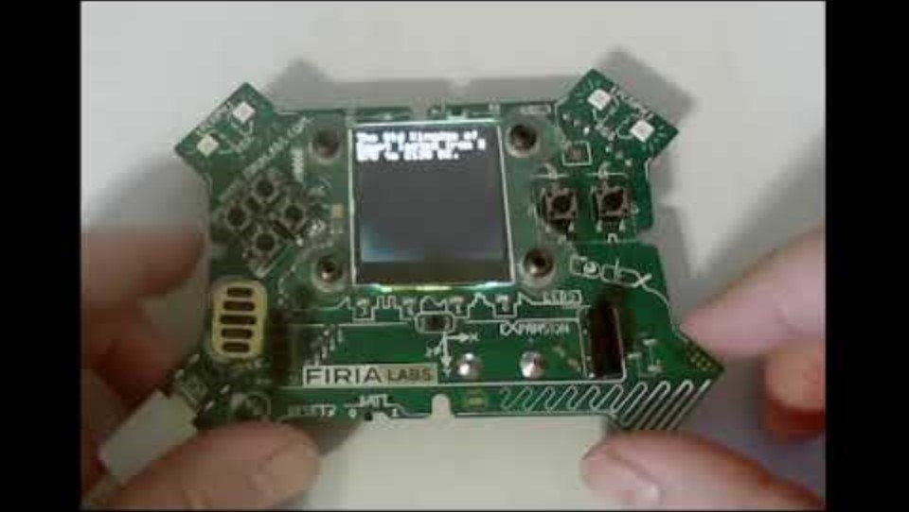
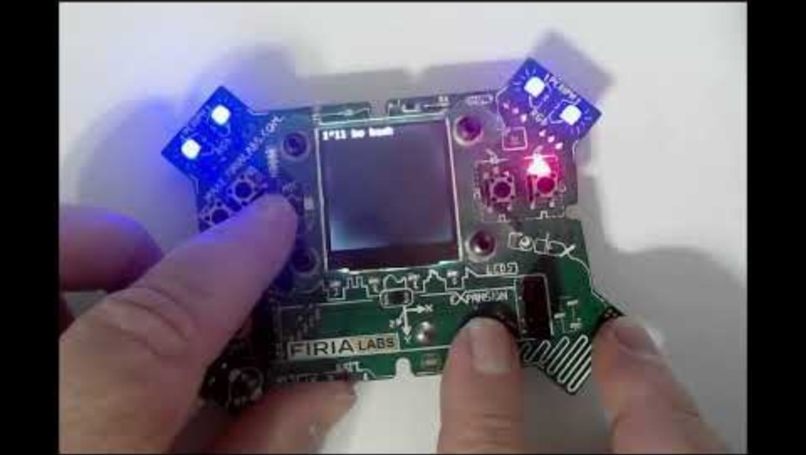
Step #2
Extra Spicy
Add another list with colors. Use the list to light the pixels a different color for each corresponding item in the list.
Optional: light up the red LED light above A or B when the button is pressed.
# Example for button LEDs
# Turn on the LED above button A
leds.set(LED_A, True)
Spicy
Create 2 lists and use BTN_A and BTN_B to determine which list to display. Then use BTN_L and BTN_R to scroll through the lists. The lists can be anything that interests you, or facts from two different subjects.

Slide 11
Step #2
Brainstorm ideas
Read through remix suggestions from your teacher (previous slides)
Use the suggestions as presented, or combine some of the options for your own spicy or extra spicy project
Use your creativity to come up with your own idea for a project
Decide with your partner what project you will do
DO THIS:
Fill out the information in the Mission 7 Remix Log for Step #2

Slide 12
Step #3
Make a plan
What variables will you need? What will you use them for?
What lists will you use, and what will be their items?
What buttons will you program, and what will each button do?
DO THIS:
Fill out the information in the Mission 7 Remix Log for Step #3

Slide 13

Step #4
Code your project
IMPORTANT: In CodeSpace, go to the sandbox
Start with a new file and give it a descriptive name (Remix7)
You can leave any program open, including Billboard, and use it as a guide
Import your modules
Create your lists and define your variables
Write your code, testing frequently

Slide 14
Step #4
Stop and test frequently!
Don’t try to write all the code at one time
Mistakes happen, so find them early
Type just a few lines of code and then run the program
If there is an error, fix it before continuing
Use the debugger and your other programs for help

Slide 15
Step #5
Documentation!
Make sure your code is readable by adding blank lines
Add comments to sections of your code that explain what they do

Slide 16
Step #5
Get feedback
Show your code to other students
What do they think? Have them fill out the feedback form on your Mission 7 Remix Log
Give yourself some feedback Is there something you want to change or improve or add? Fill out the feedback form on your Mission 7 Remix Log
Modify your code to make your project even better

Slide 17

And now you have your own remix!
Congratulations!
By completing this remix you have:
learned more about programming
practiced the skills and concepts from the missions
been thinking! And problem solving and much more!

Slide 18
Mission Reflection
Wow! Great job!
Share your project with your friends!
Run at least three projects from other students
Complete your Mission 7 Remix Log
Don’t forget to clear your CodeX by running your Clear program

